Slide 1
Quick view: React project

Slide 2
Describe
Live chat software between two different types of users: jobseeker and employer
Port - localhost:3000
run - docker-compose up

Slide 3
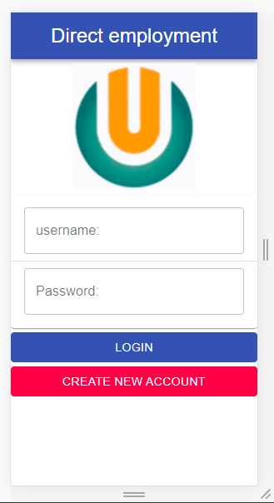
First page: login

Slide 4
Technologies involved
  Javascript, JSX
  React, Material-ui: Frontend
  Node.js, express: Backend
  Axios, Socket.io: Transform data
  Mongodb, mongoose: Database
  Redux: State Container
  Docker, Docker-compose: Virtualization

Slide 5
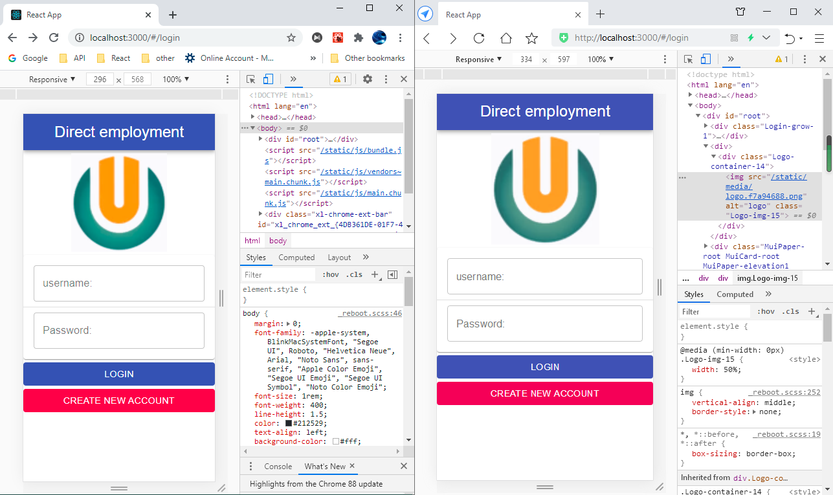
Open two different brands of browsers to start testing

Slide 6
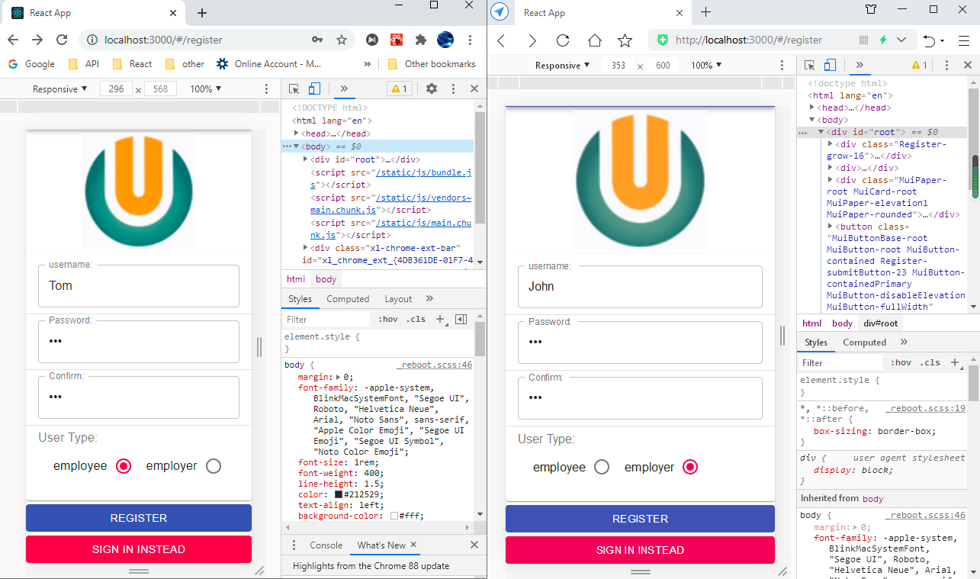
Create two different types of users

Slide 7
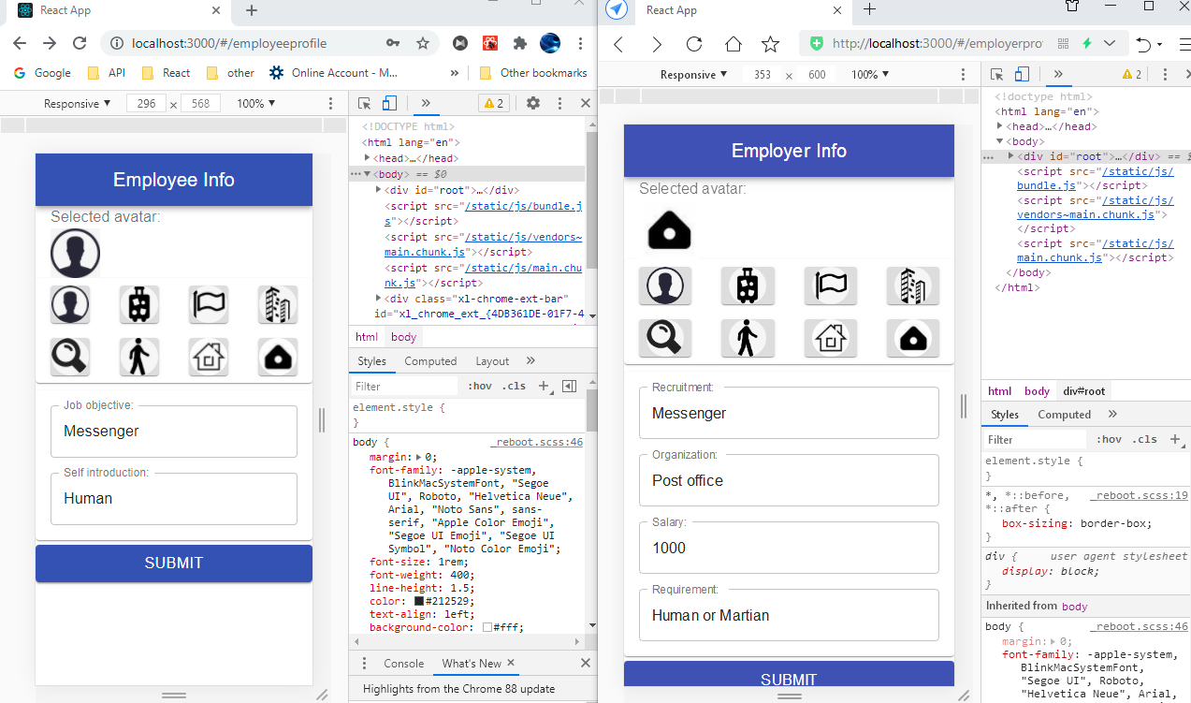
User profile: the registration process only ends when the avatar is selected

Slide 8
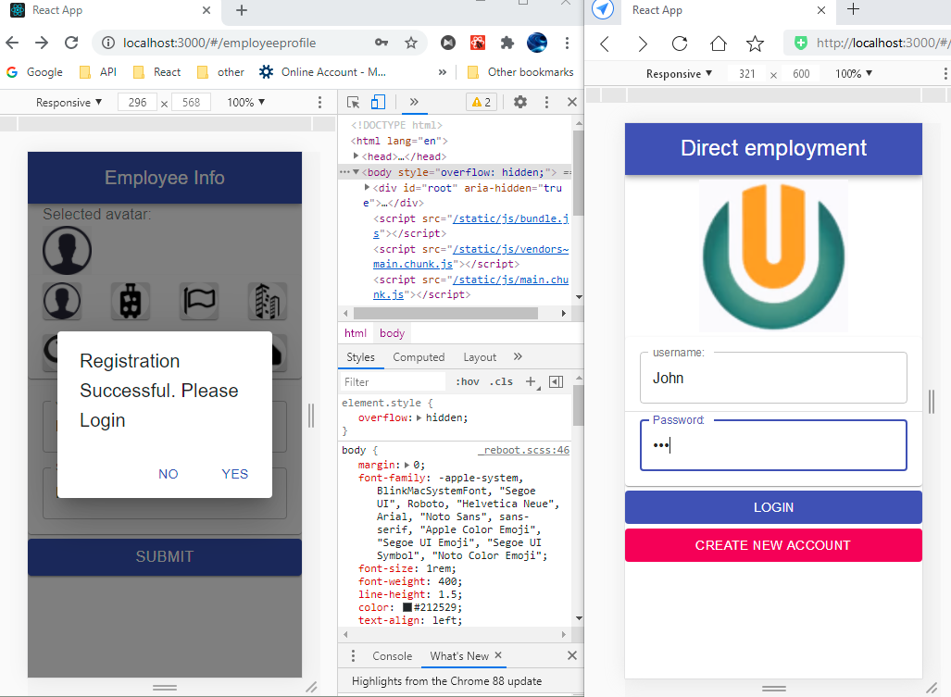
After registering, user need to relogin

Slide 9
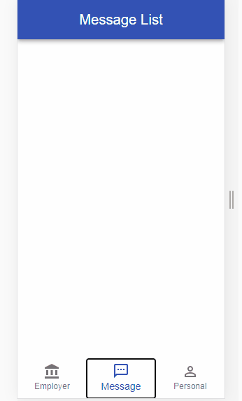
Main page: user list
(Show list of user in the other type)

Slide 10
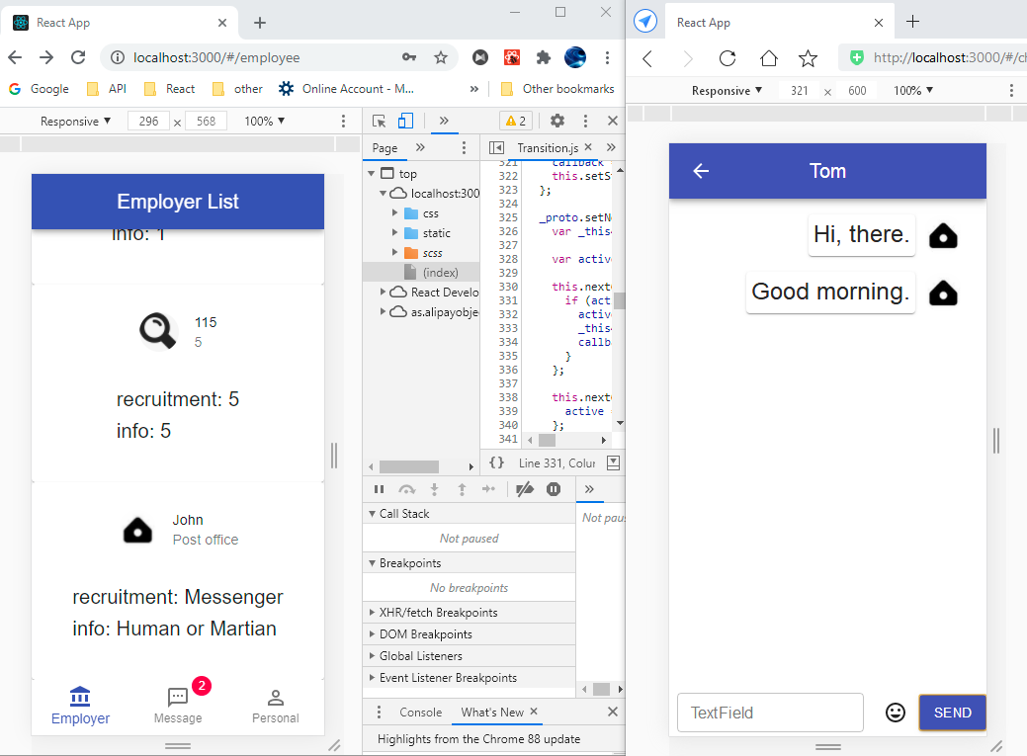
Click on the user dashboard to chat
(Unread information prompt)

Slide 11
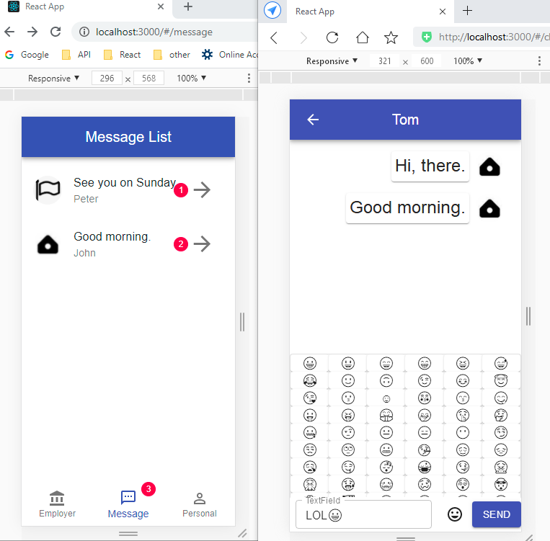
Message list: display the last one of all chat messages

Slide 12
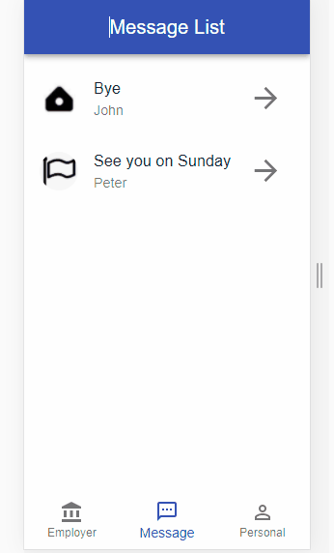

Slide 13
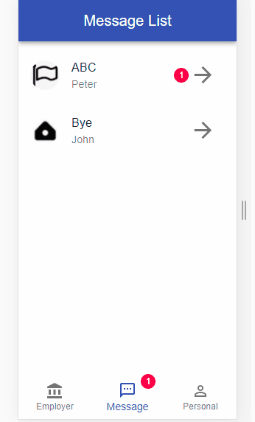
Unread prompt will disappear after reading

Slide 14
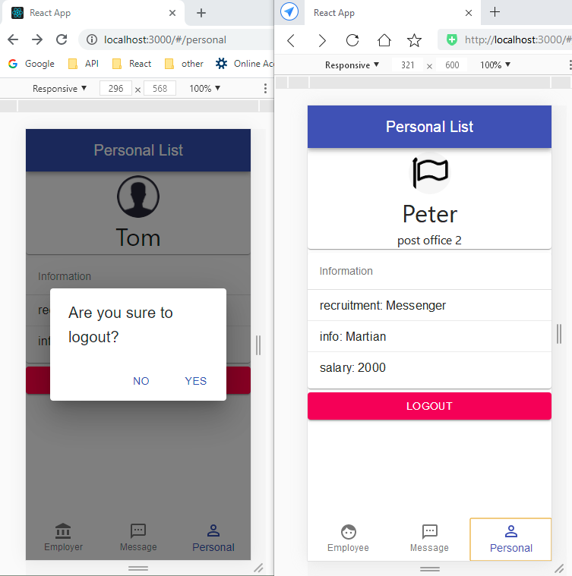
Logout

Slide 15
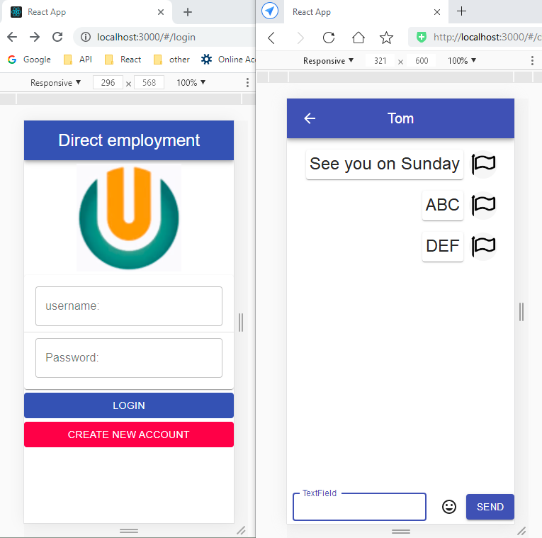
Messages can be sent to logged out users

Slide 16
Bug solved
Newly registered users can directly get the user list now.
Chats from newly registered users will also generate prompts
When receiving a chat from a newly registered user who is not in the local user list, it can also be correctly displayed in the Message

